Slide 1
Coding Dojo Big Data
Session 2/8: Kafka Streams

Slide 2
Last session review
Kafka
Broker
Topic (partitioned)
Producer
Consumer
Exactly-once
Unit tests
Reading material
https://www.confluent.io/blog/
https://www.confluent.io/resources/kafka-the-definitive-guide/

Slide 3
Introduction
Stream processing
DAG (Dependency Acyclic Graph) of source, processing and sink nodes
Multiple projects

Slide 4
Introduction
Stream processing
DAG (Dependency Acyclic Graph) of source, processing and sink nodes
Multiple projects:
Spark Streaming,
Flink,
Storm,
Kafka Streams

Slide 5
Introduction
Stream processing
DAG (Dependency Acyclic Graph) of source, processing and sink nodes
Multiple projects:
Spark Streaming, (Framework)
Flink, (Framework)
Storm, (Framework)
Kafka Streams (Library)

Slide 6
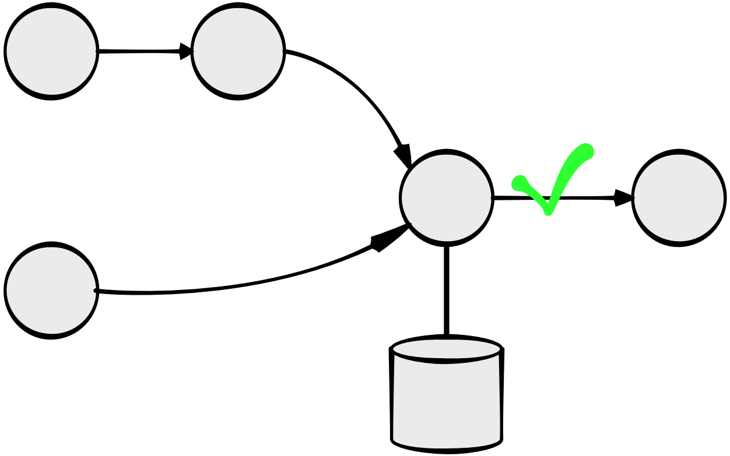
Stream Processing
Processing and Checkpointing

Slide 7
Kafka Streams
Library
2 levels
DSL (High Level)
Processor API (Low Level)
RocksDB for stateful processing
Link
https://docs.confluent.io/current/streams/developer-guide/dsl-api.html

Slide 8
Kafka Streams DSL
Co-partitioned topics
Topology with KStreams, KTables, GlobalKTables
Stateless vs Stateful
Windowing
Operations
Input, output
Map
Merge
Join
Aggregation
…

Slide 9
Kafka Streams Processor API
Low level
Topology with 3 node types
Source
Processor
Sink
Stores

Slide 10
Kafka Streams: Hands-on
Data
Reference: (user_id, user_name)
Event: (user_id, message)
Producer (day 1)
Produce records: reference data and events
Stream processing (DSL)
Consume records: reference data and events, then join and output.
Unit Tests
Test stream processing
Stream processing (Processor API)

